Slide 1

Team 11
Solution for assigning and monitoring routes.

Slide 2
Outline
Scope
Our proposal
Future Ideas

Slide 3
Scope
Trying to help disadvantaged people.
Reduce the amount of work required to plan the service.
Facilitate the inclusion of more than one meal service a week.
Increase awareness about the service.

Slide 4
Our proposal
An integrated web service and mobile application to aid with logistics
A system to support a small NGO make an impact
Leverage widely-used technologies

Slide 5
The Web Service

Slide 6
Easy to use Effective

Slide 7
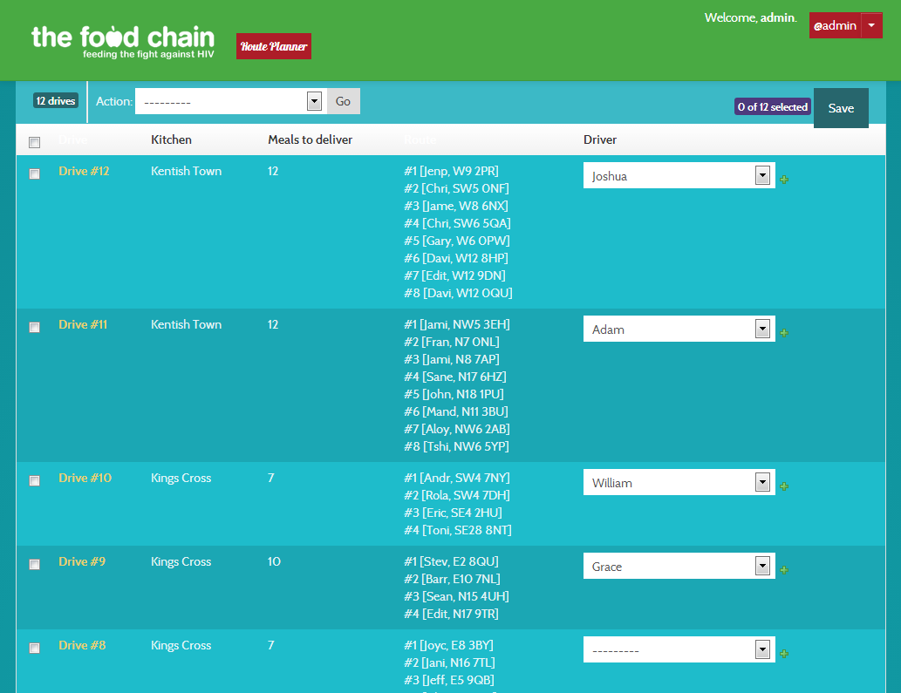

Slide 8
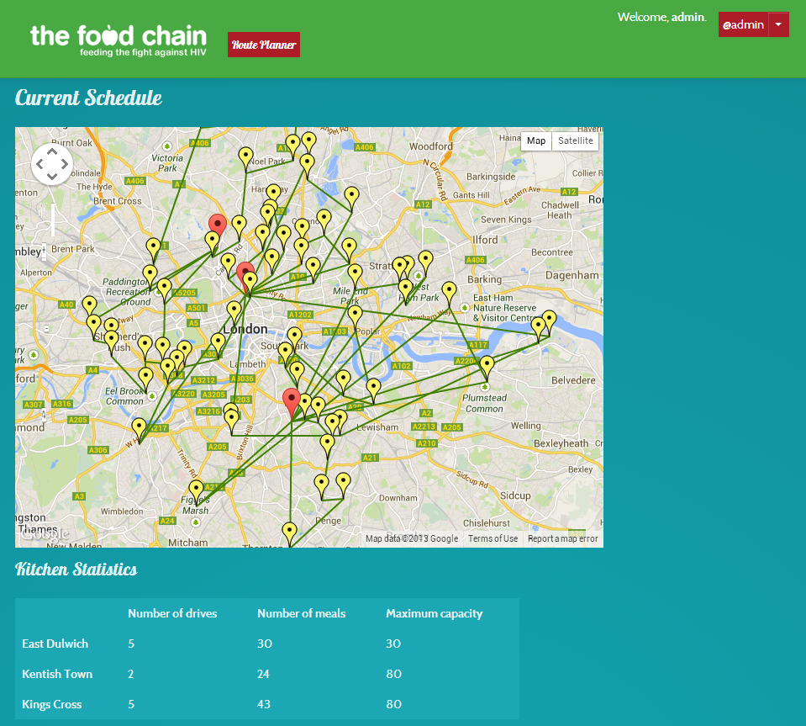

Slide 9
The Mobile Application

Slide 10
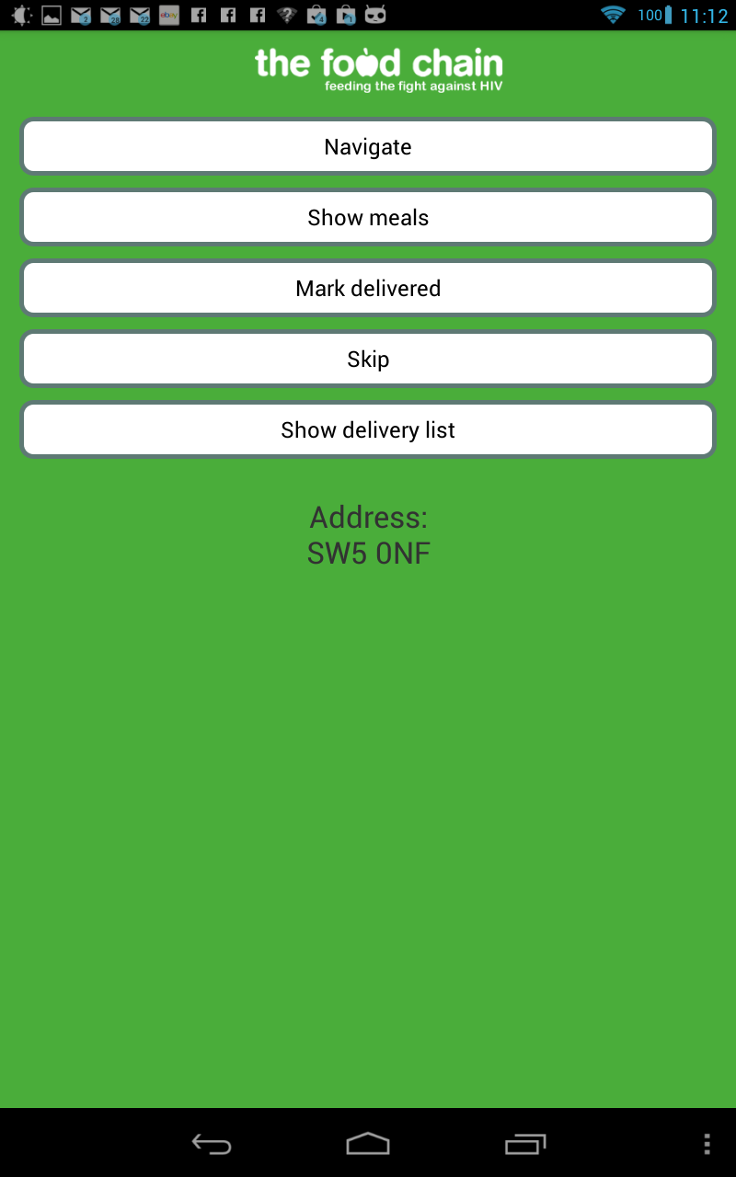

Slide 11
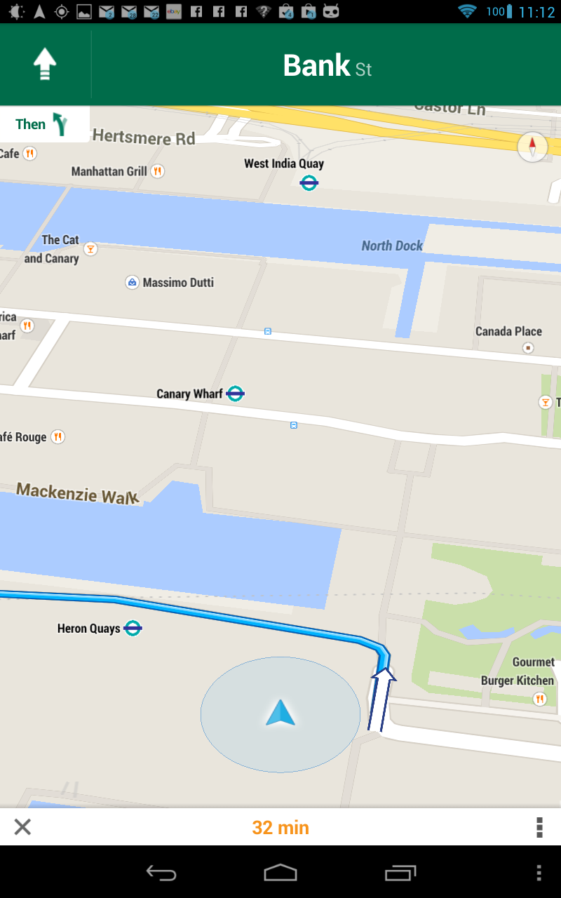

Slide 12
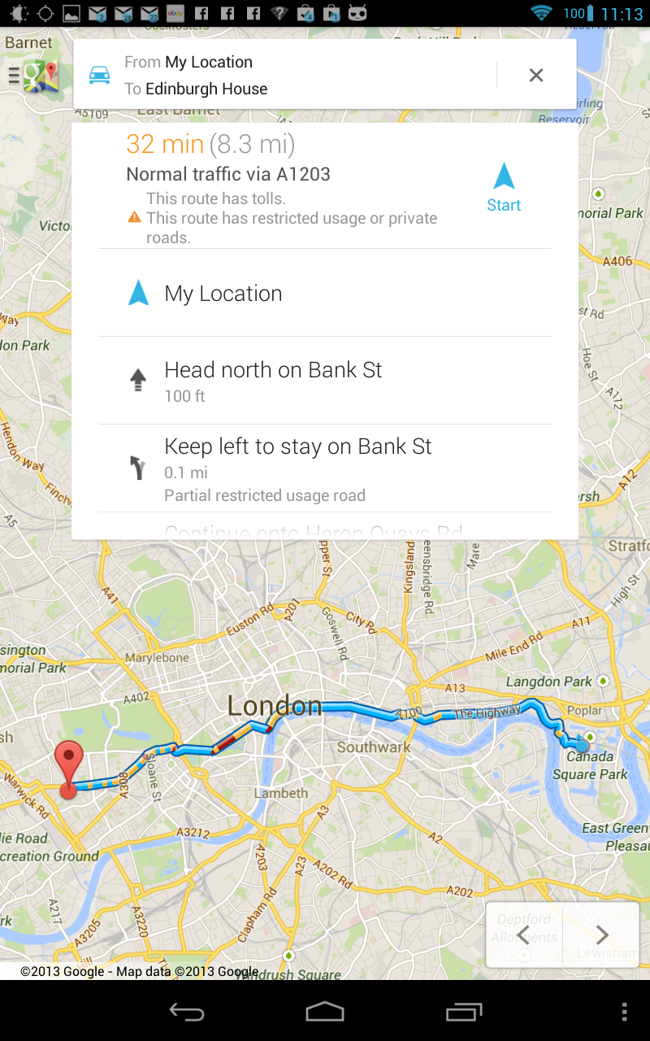

Slide 13
Future Ideas
Make the application available for use on other mobile devices
Provide the software platform to other NGOs Raise awareness about the initiative

